Slide 1
POWER YOUR BUSINESS
With Customer Feedback & Online Reviews

Slide 2
BENEFITS
Grow your revenue and marketing by impacting SEO, reviews, and social proof
Reduce negative reviews by making feedback easy for your customers
Save time and money with a simple, robust and actionable solution

Slide 3
Reviews Build Proof & Trust
Reviews give potential customers more information about your business that can help tip the scales in your favor.

Slide 4
Review Matter
Customers are looking at reviews to learn about your business
76% of consumers always or regularly read online reviews when browsing for a local business
89% of consumers are highly or fairly likely to use a business who responds to ALL reviews.
Conversely, 57% of consumers are not very likely or not likely at all to use a business who doesn’t respond to any reviews
55% of consumers would feel positively about a business if the owner has responded to reviews
https://www.brightlocal.com/research/local-consumer-review-survey/

Slide 5
Feedback Request Process
Create a simpler, more effective request process that asks every customer for feedback and provides a true reflection of your business’ reputation.

Slide 6
Requesting Reviews
Customers will respond if you request reviews properly
Businesses with more than the average number of reviews across ALL review sites bring in 54% more in annual revenue*
After having a positive experience, 77% of customers would recommend it to a friend**
*https://www.womply.com/impact-of-online-reviews-on-small-business-revenue/
**https://www.xminstitute.com/blog/cx-leads-to-recommendations/

Slide 7
SEO Benefits of Reviews
Be found easier when you add local user-generated content to your website.

Slide 8
SEO Benefits
Drive up search results and engagement
In 2021, reviews were the 2nd most important local ranking factor for business*
Offsite SEO-related factors like reviews carry more than 50% of the ranking factor weight**
Review snippets in organic search results can increase clickthrough rates by up to 35%**
*https://whitespark.ca/local-search-ranking-factors/
**https://searchengineland.com/how-customer-reviews-can-improve-your-seo-efforts-378252

Slide 9
GENERATE
MANAGE
MARKET
Tools to help you generate feedback, reviews, and ratings all in one place.
Email or SMS
Review Monitoring for 50+ sites
Kiosk Mode, Feedback URL and Locator
Integrate with other popular software
Manual or customer list upload
Actions that help you manage customer experience, users, insights, and reporting.
Receive new feedback and review notifications
Read & Respond
Auto-tagging of themes
View reporting
Insights Report
Inbox for review responding
Use feedback and reviews to market your business, improve SEO, and win new customers.
Review Widget displays reviews on your website
Share reviews on Social Media channels
Add social proof with Conversion Pop-up
Generate 3rd-party reviews
Impact SEO and get review stars in search results

Slide 10
GENERATE
Let’s look at how we generate customer feedback and reviews from your customers and the web

Slide 11
GENERATE
Email or SMS Requests
Single or list upload
We help you proactively ASK for feedback and reviews
Inbound SMS/Text
Customer-activated feedback
Your customer shops with you, buys from you, or completes a service with you and we help you ask them for feedback and online reviews.
We have numerous proactive methods to help engage as many of your customers as possible.
Email and SMS requests have many options using 3 base ”Request Modes”.
Kiosk Mode
iPad or smartphone
Integrate
API, Zapier, or Webhooks

Slide 12
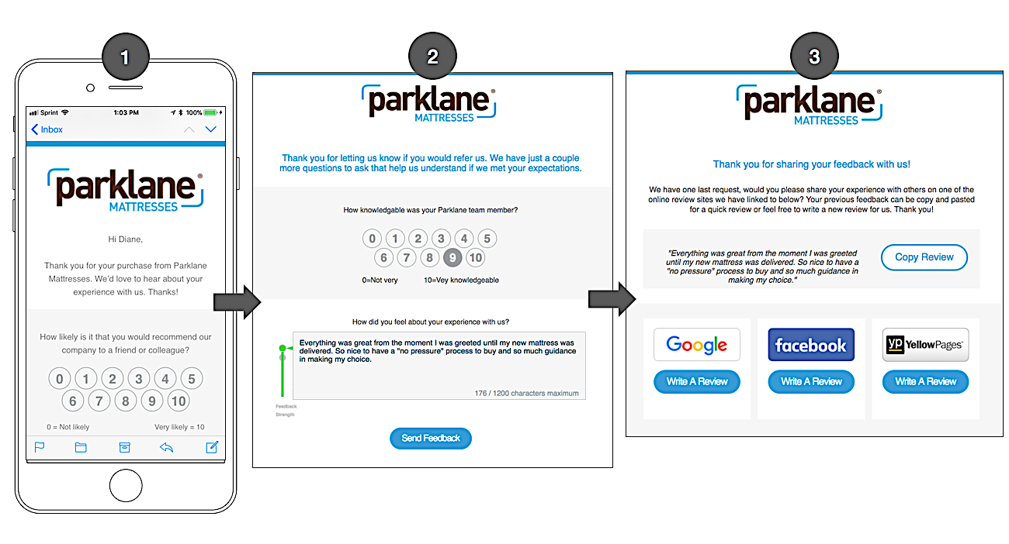
GENERATE
Ultimate Mode
3-Step process that requests:
NPS Score
Direct Feedback/ 1st Party Reviews
3rd Party Reviews

Slide 13
GENERATE
Ultimate Mode
3-Step process that requests:
NPS Score
Direct Feedback/ 1st Party Reviews
3rd Party Reviews

Slide 15
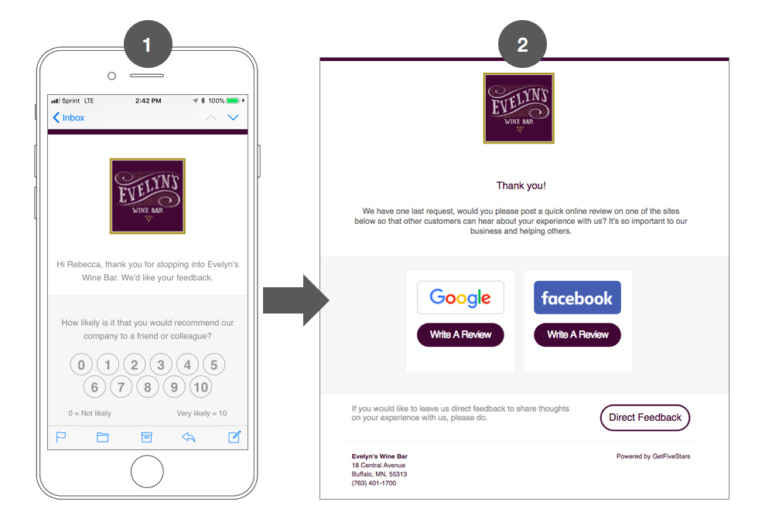
GENERATE
Review Mode
2-Step process that requests:
NPS Score
3rd Party Reviews

Slide 16
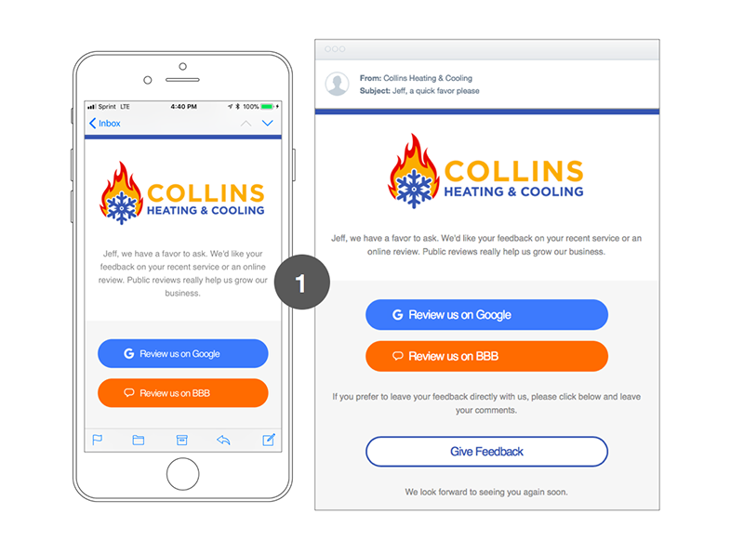
GENERATE
Direct Mode
1-Step process that requests:
3rd Party Reviews

Slide 17
GENERATE
Feedback URL
Share link to social or anywhere
Make feedback EASY for your customer with passive entry
Leave Feedback Button
Display in online widget
Offering a number of easy and accessible entry points for a customer to give you feedback is key.
Reduce negative reviews by showing you are a “feedback first” business.
Feedback Locator
For franchises & multi-locations

Slide 18
GENERATE
Monitor new 3rd-party reviews on sites like Google
We monitor the sites you select on a daily basis to detect new online reviews.
Email notifications are sent and all of your review data is captured in our system so you can learn, report, and respond. We offer over 50 sites to choose from.

Slide 19
MANAGE
Features, tools, and reports so you can learn from, manage, and respond to your customers.

Slide 20
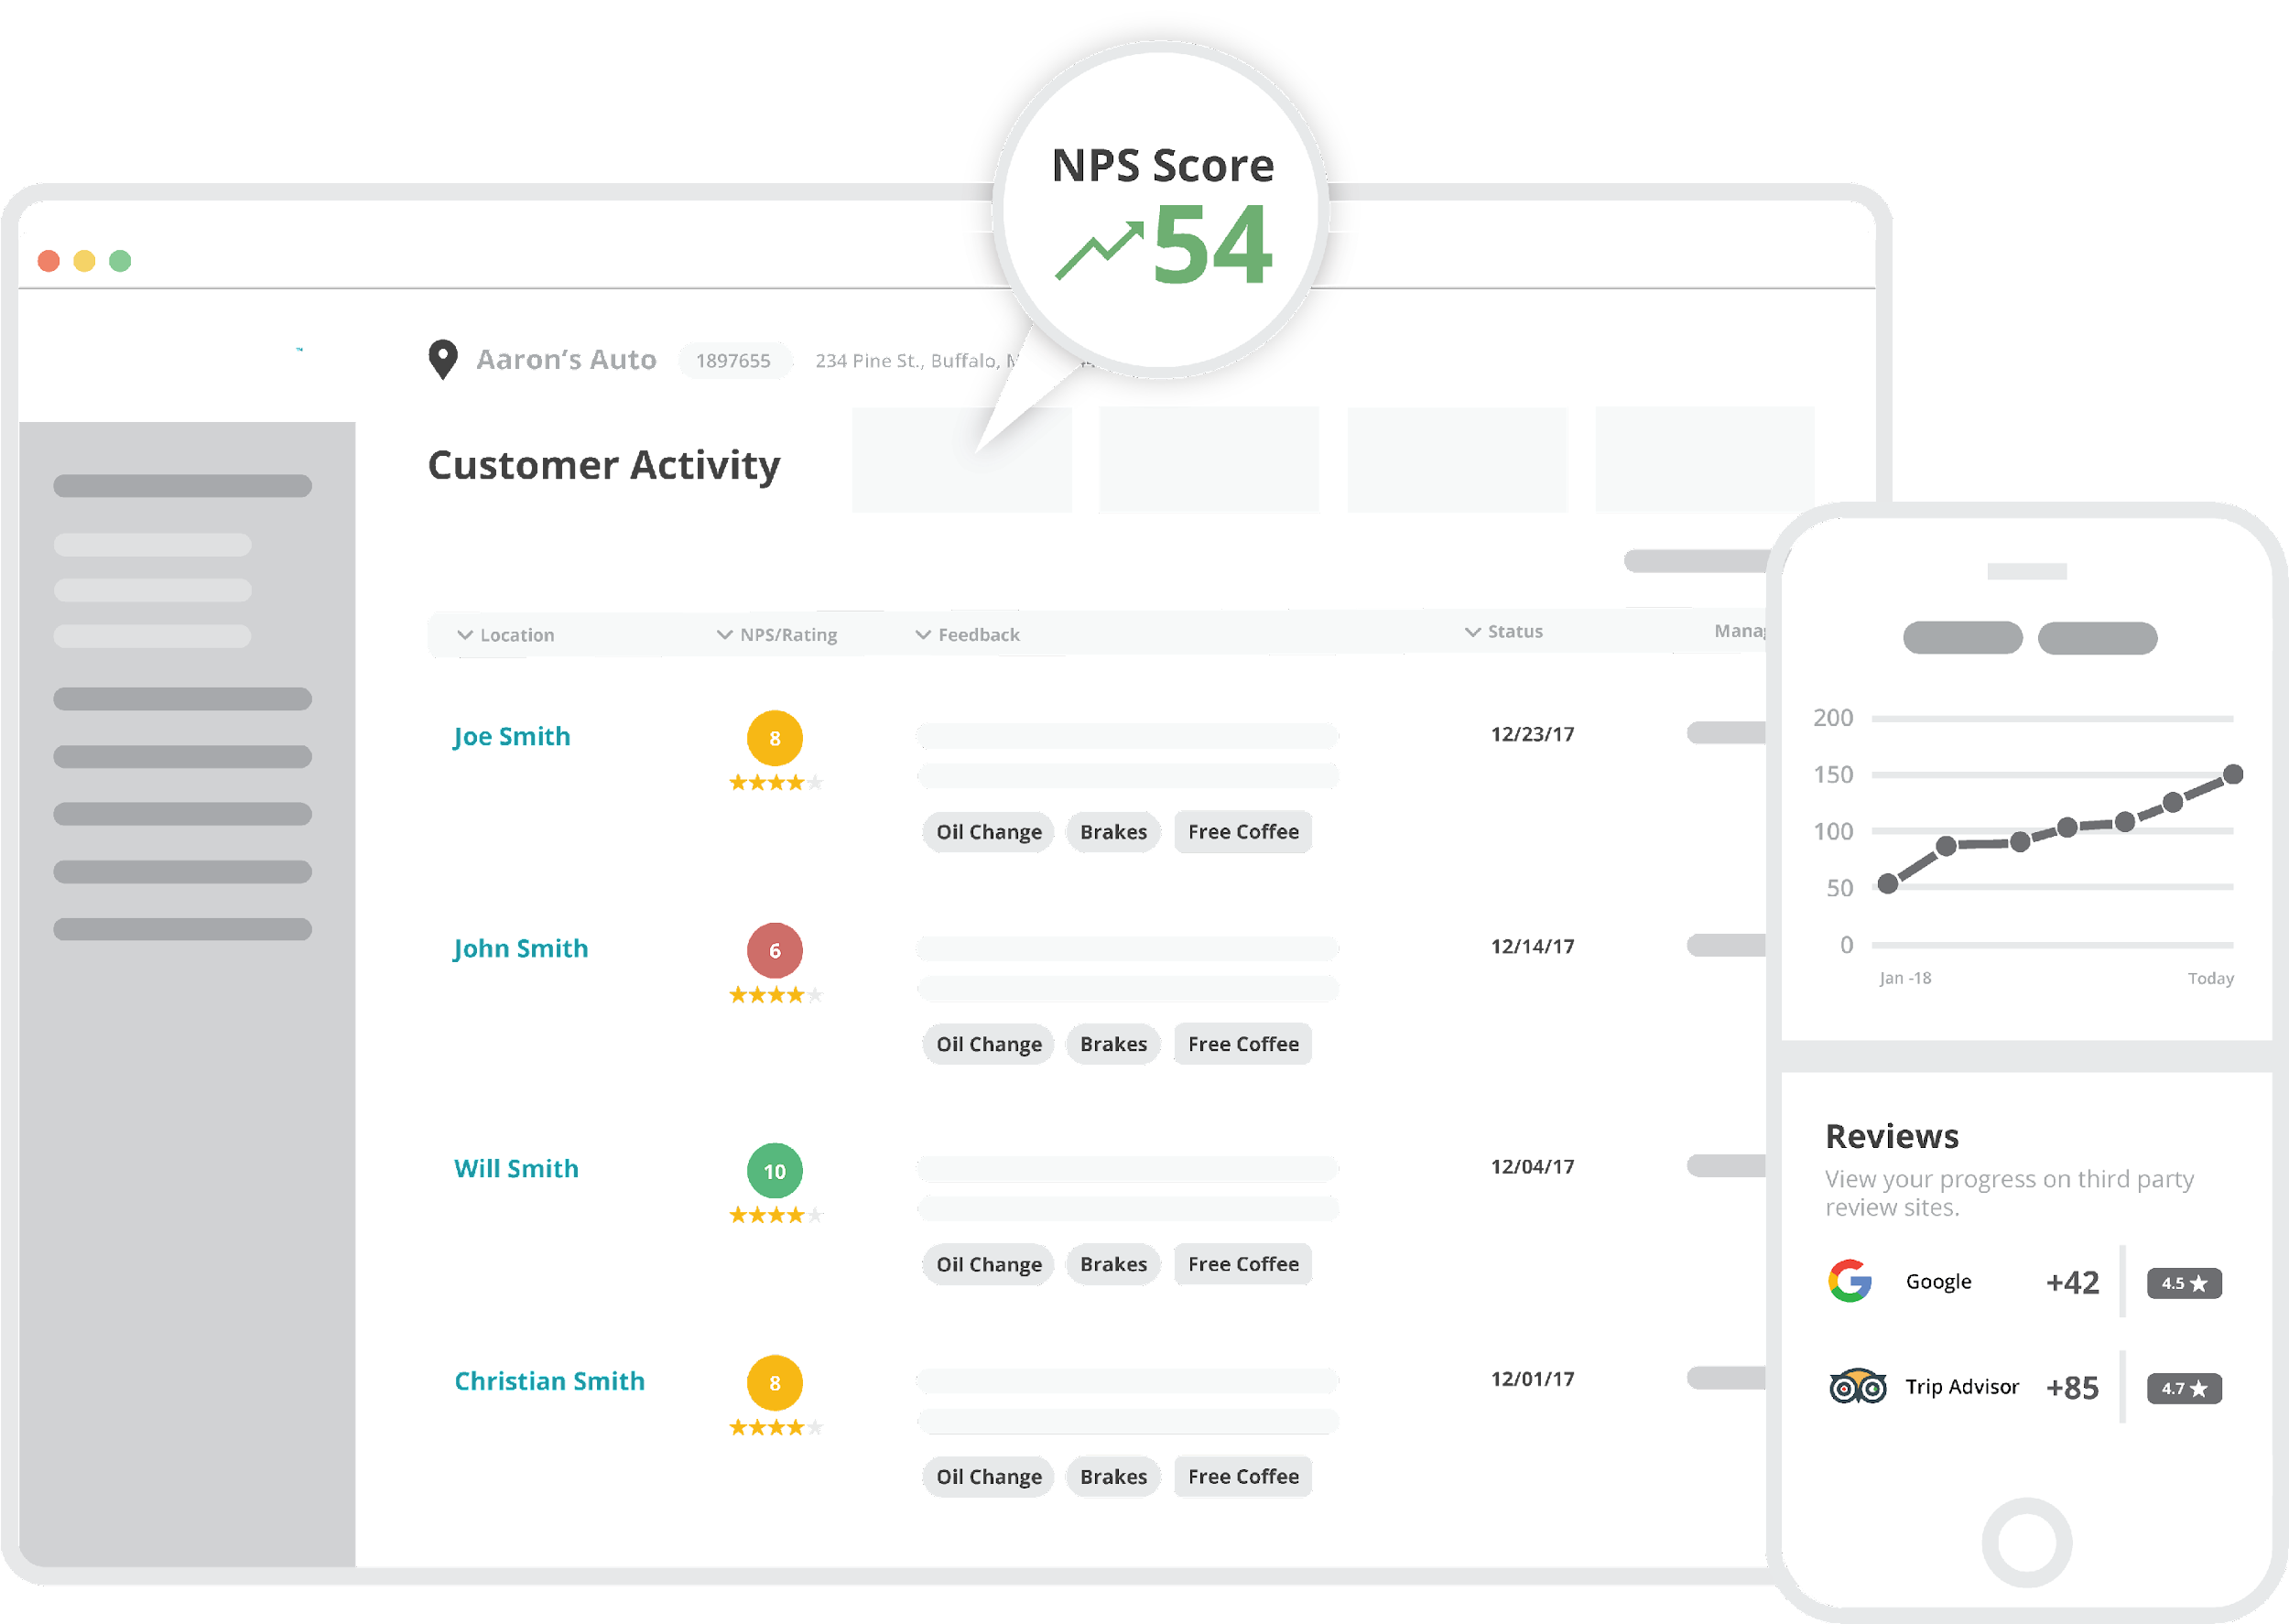
MANAGE
Customer Activity puts all of your customers in one place
Tap into the live stream of your customers and their experiences.
See all of your customers in a single source view with endless options on how you can filter and take action.
Read customer feedback, respond, view statuses, and more.

Slide 22
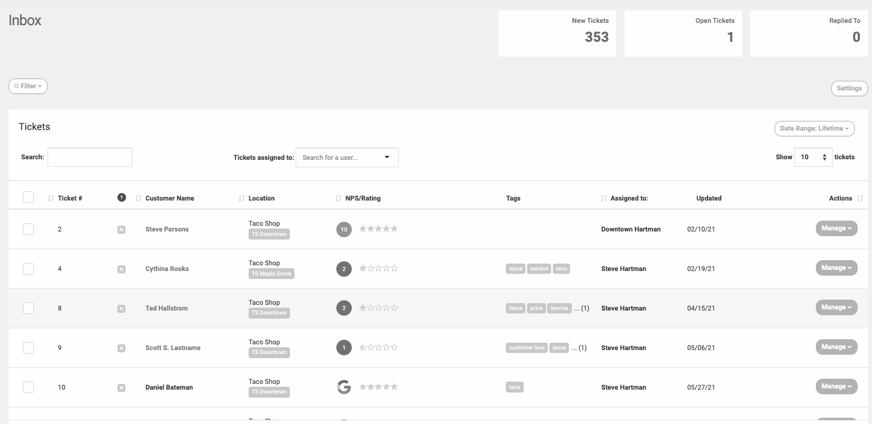
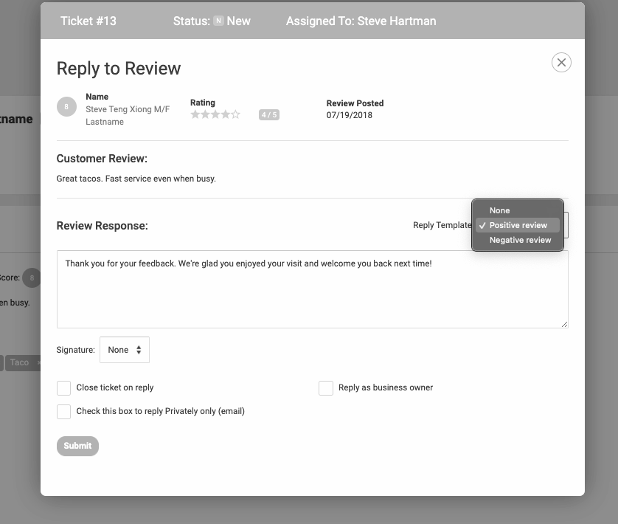
MANAGE
Inbox is the tool for precise response management
Create tickets and assign them to your team
Provide employees with templated responses to help manage messaging
Track the progress of responses from within GatherUp’s centralized Inbox screen

Slide 23
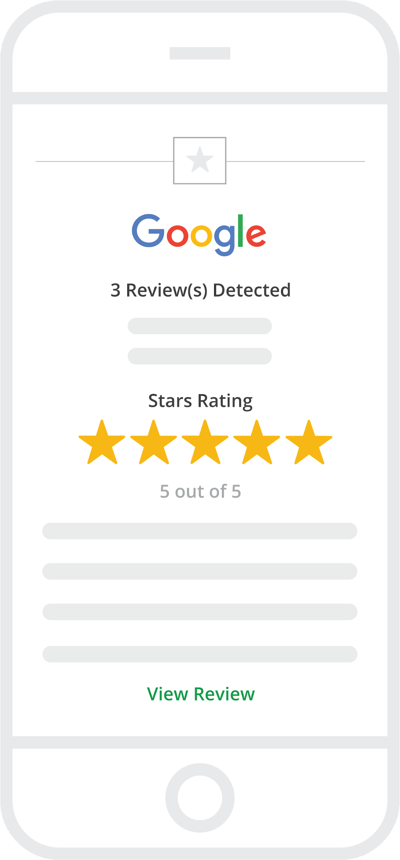
MANAGE
Receive email notifications when new interactions happen
Our service not only captures customer data for your account, we send email notifications for specific actions including:
New customer feedback – good or bad
New 3rd-party online reviews
New Google Q&A content
Automated weekly or monthly email reports

Slide 24
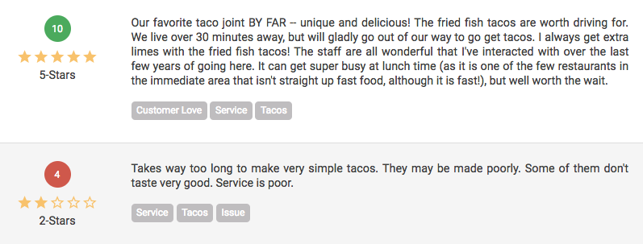
MANAGE
Identify themes with Auto-Tagging
Create themes by building tags from specific keywords. Auto-Tagging automatically applies tags to reviews help you to uncover valuable insights by understanding key areas of the experience.
Build custom “Tag Widgets” to display content specific reviews on your own website.

Slide 25
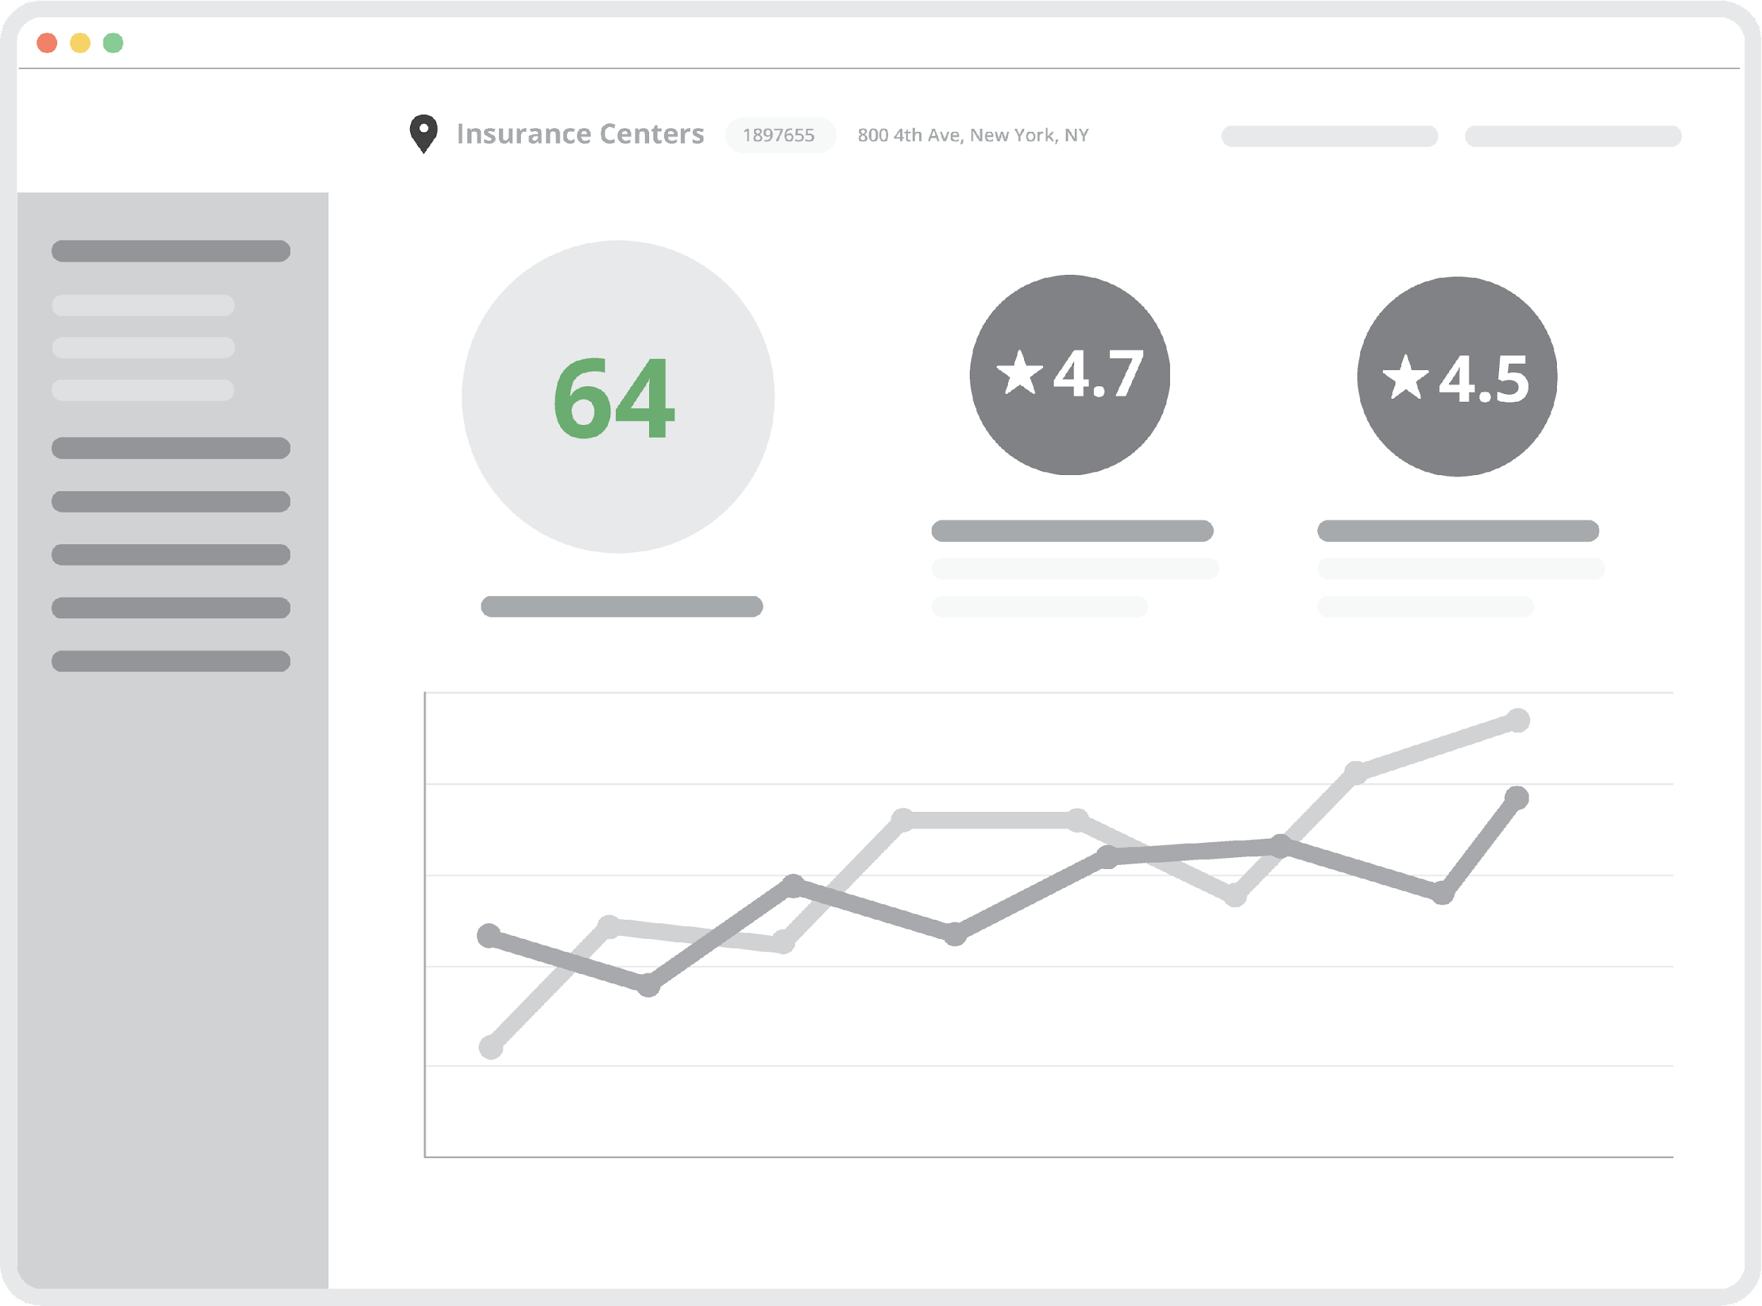
MANAGE
A full reporting suite to view the data you need to grow
Featuring a robust set of reports, you can view data in many ways to manage your customer’s experience.
Benefit from the control of date ranges, actions, review sites, rating types, tags and more to understand your business better every day.

Slide 26
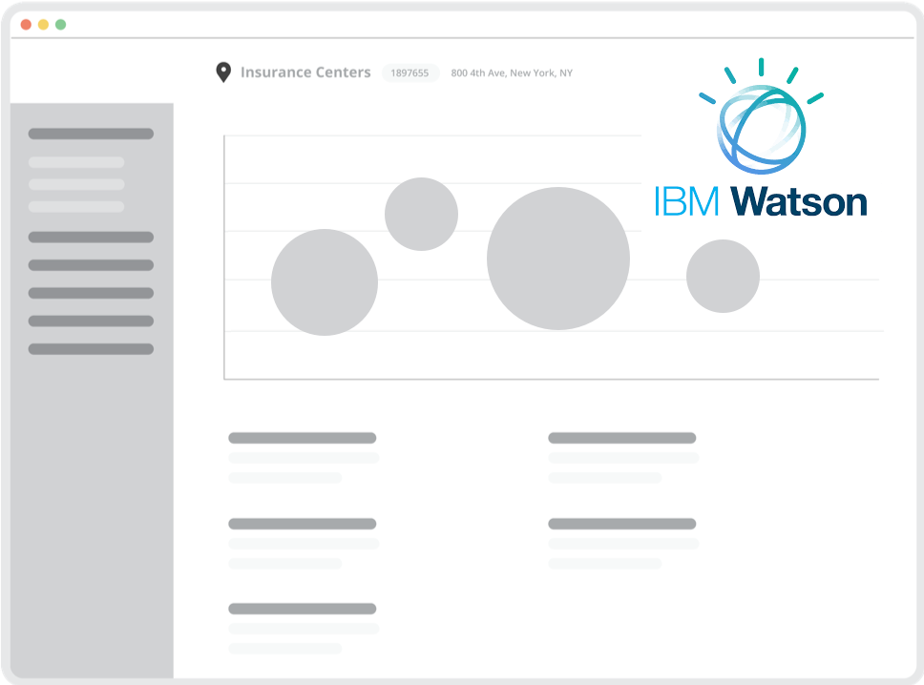
MANAGE
Discover what you don’t know with Insights Report
Insights Report uses Artificial Intelligence and Natural Language Processing to uncover keywords, impact, sentiment, and trends in your reviews powered by IBM Watson.
The Insights Report analyzes all of your review data for:
•Keyword and Tag sentiment
•Review rating impact
•Trends

Slide 27
MARKET
Fuel your marketing with customer generated content to showcase reviews, improve SEO, and win new customers.

Slide 28
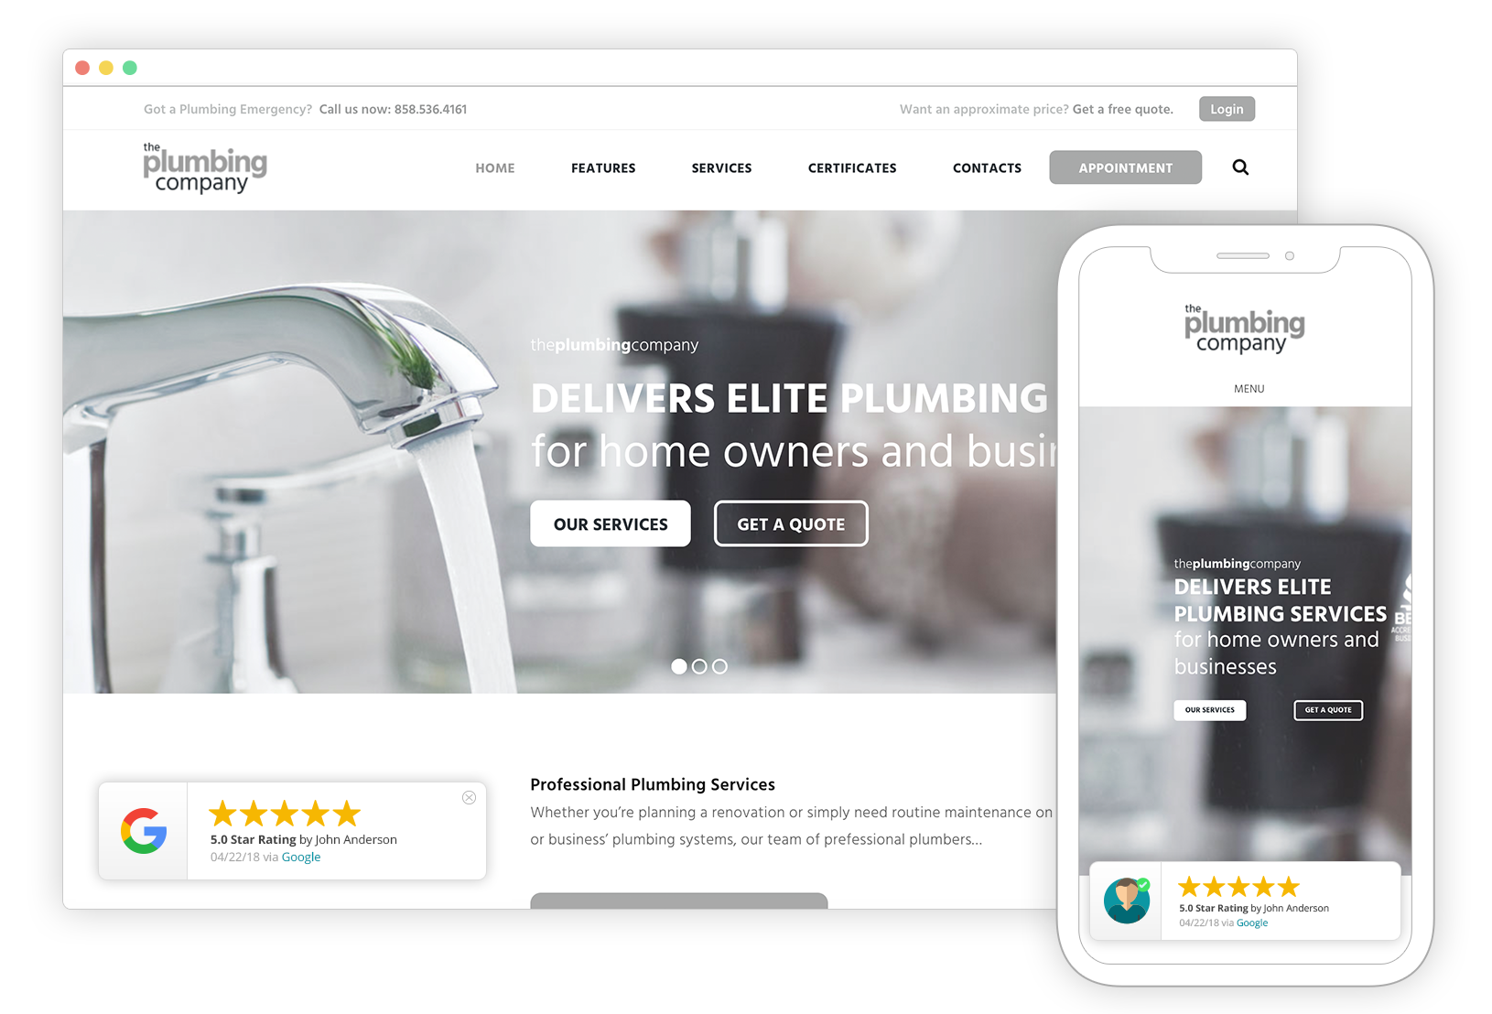
MARKET
Conversion Pop-up adds social proof to your website
Bring a visually appealing display of your latest ratings and reviews right to any page of your website.
Build social trust and convert more website visitors to contacts by leading with reputation.

Slide 29
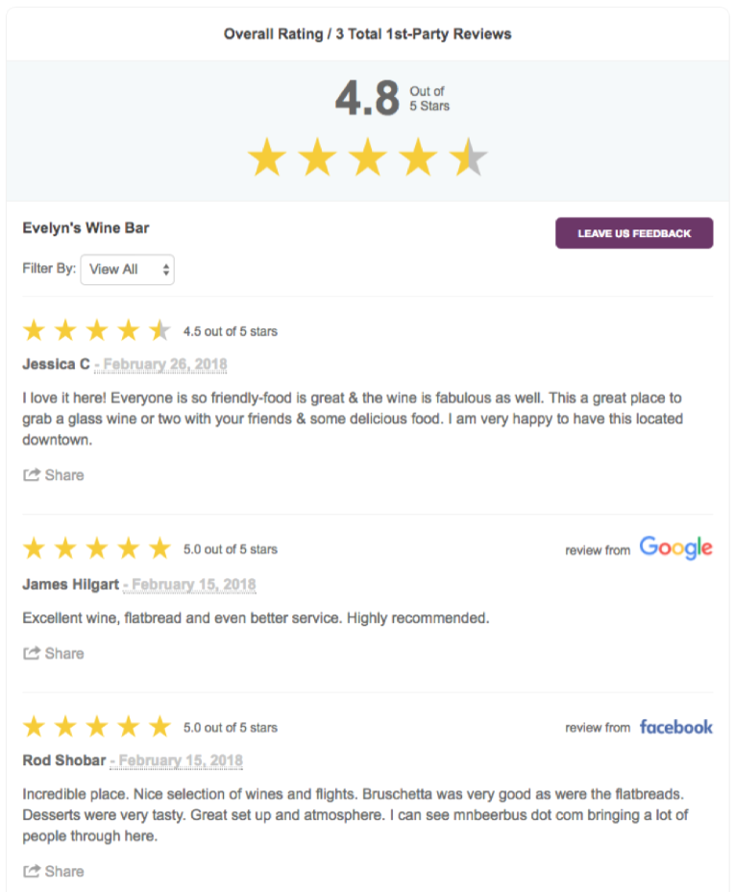
MARKET
Get the BEST Review Widget on the market
Review Widget is the one everyone else is chasing.
Easily integrated into your website, Review Widget displays selected 1st-party reviews (with review schema for SEO benefits) as well as selected 3rd-party reviews for additional social trust.
Numerous settings, options and more.

Slide 30
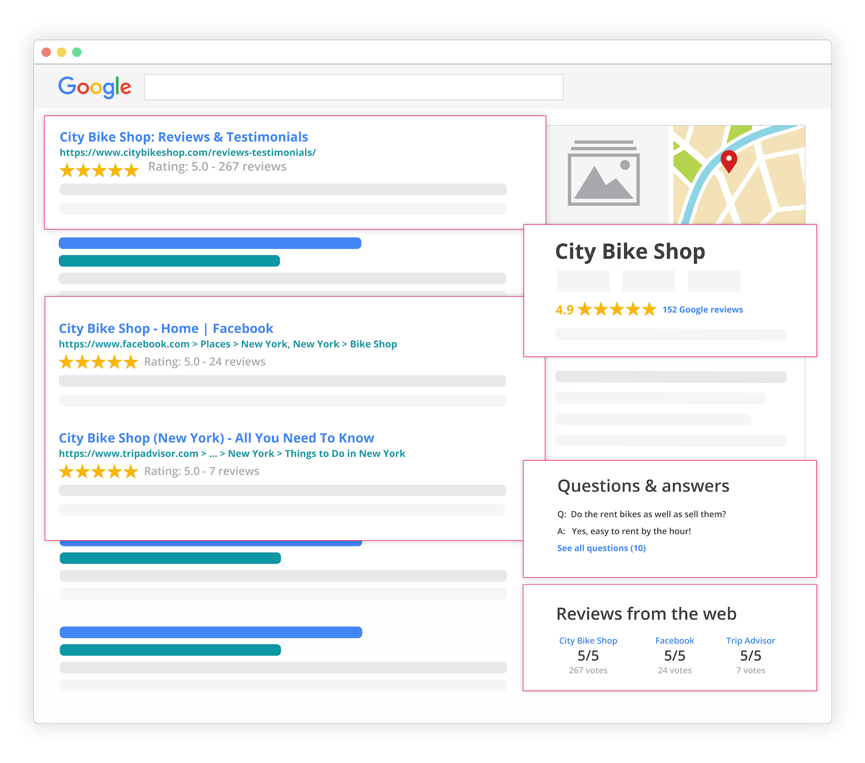
MARKET
Manage your reputation in search results
We influence the majority of reputation results from Google Searches about your business.
Because the Review Widget includes review schema you can reap the benefits of SEO and enhanced search results to help you compete on search engine results pages.

Slide 31
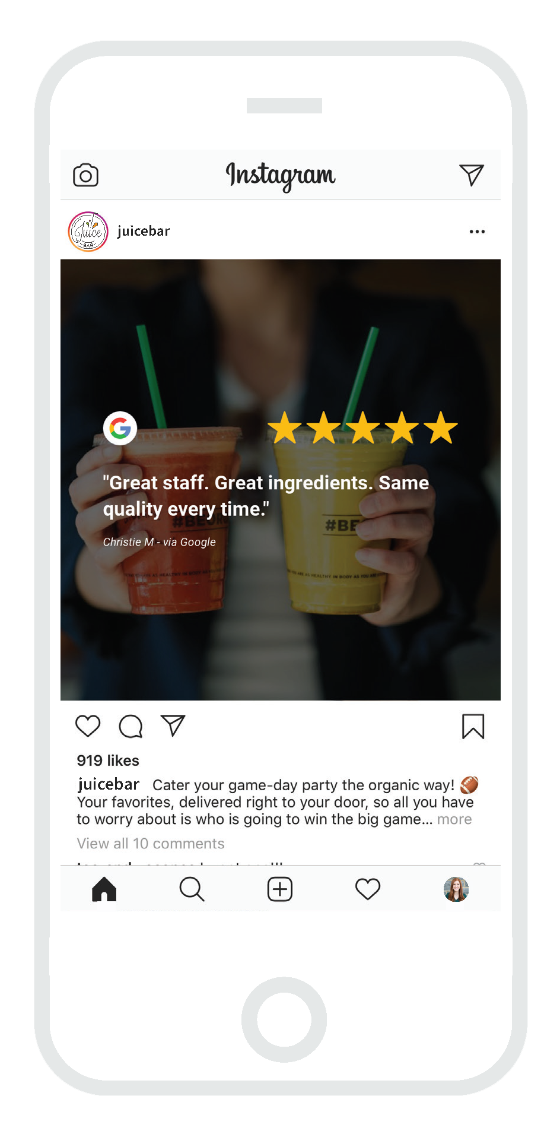
MARKET
Social Sharing
Turn your 1st and 3rd-party reviews into eye-catching social media graphics using the image generator.
Create custom visual themes to brand images and stand out to your audience.
Post directly to Google, Facebook, Twitter and Instagram.
Set it and forget it with an automation to share on Social Media.

Slide 32
Let's power your business with reviews and customer feedback. You can GENERATE, MANAGE and MARKET your customer experience starting today.

Slide 33
THANK YOU
Any Questions?

